Slide 1
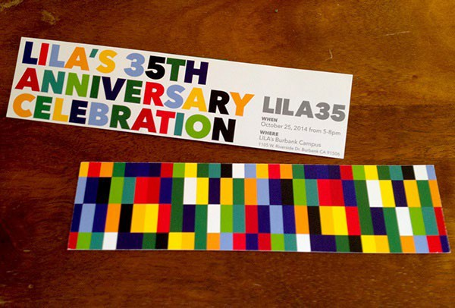
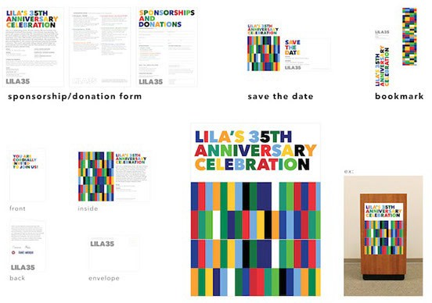
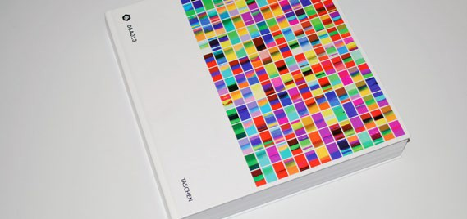
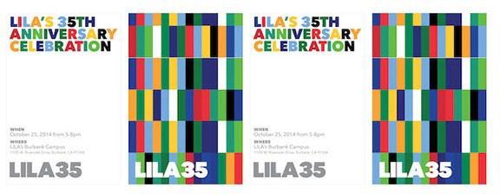
colors
use colors to create a mood and find creative ways to integrate with fonts and images

Slide 3


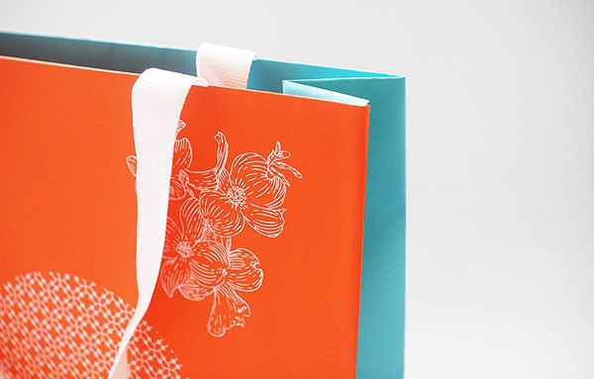
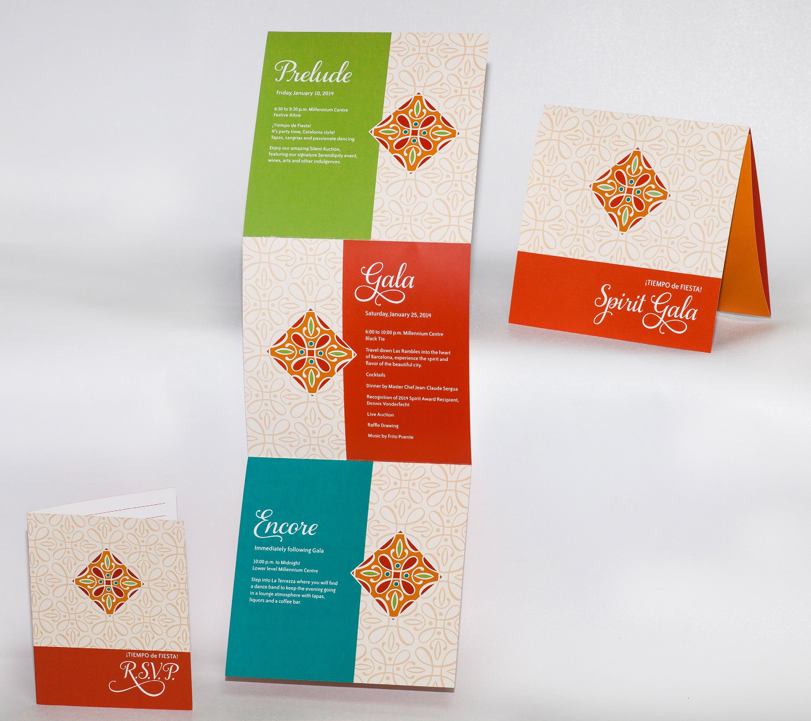


colors & pattern
use colors to create a mood, illustrations as pattern, strong font to convey exclusivity

Slide 4






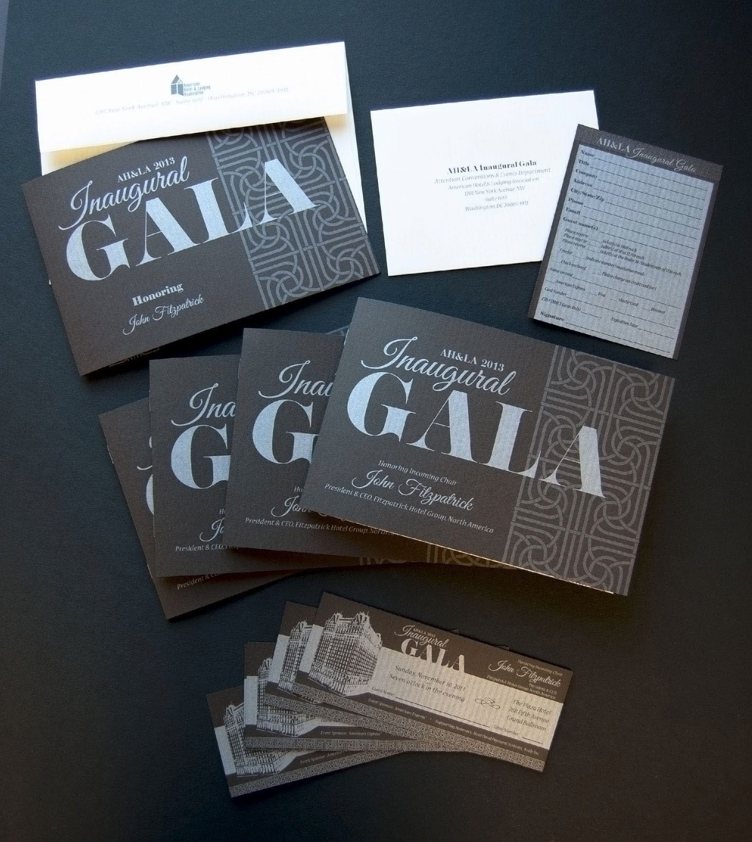

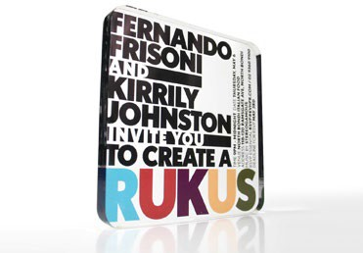
font and color
interesting treatment of word AIPAC intersecting, black and white font with splash of colors

Slide 5
illustrations
words and illustrations by hand only, using color on selective areas only

